Slide 1
Mediated sociology
Notes:
Link it to
Social construction of Reality
Manifest and latent functions
How you read news is partly through the social context you belong to and the groups you belong to

Slide 2
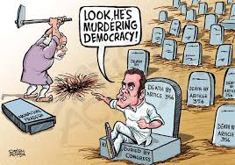
Newspapers- the real deal for democracy

Slide 3
…all news that is fit to print…

Slide 4
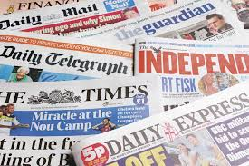
From Face to face to mediated reality
Notes:
Mediated society unlike the small scale societies – a face to face society – Gemeinschaft
Receiving society directly first hand- with scale what happens?
Emergence of mass media Gutenberg press – documents on a wide scale- not limited by what you see legends or religion – hearsay not experience or observation – religion mechanism by which peoples heads are filled with events and phenomena of which they have no direct experience- live on through legends or myths – imping on experience – generations of hearsay
How do we know from where we get the information after a while- we just see the world in a mediated way… it determines our actions – do we petition? Vote? Political? Social attitude?

Slide 5
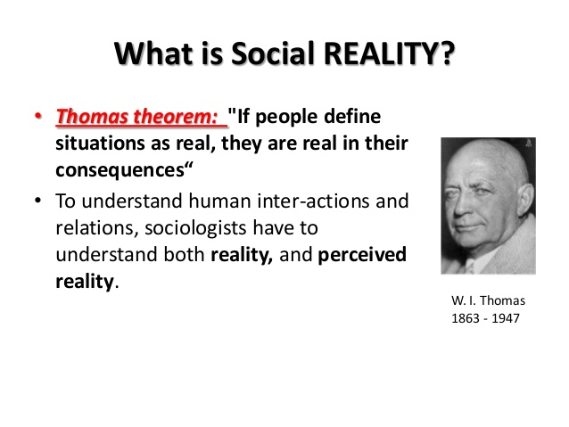
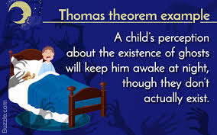
W I Thomas –anything perceived as real has …real consequences
Notes:
Mediated picture of the real- where we got it from
W I Thomas – perceived as real has real consequences

Slide 6
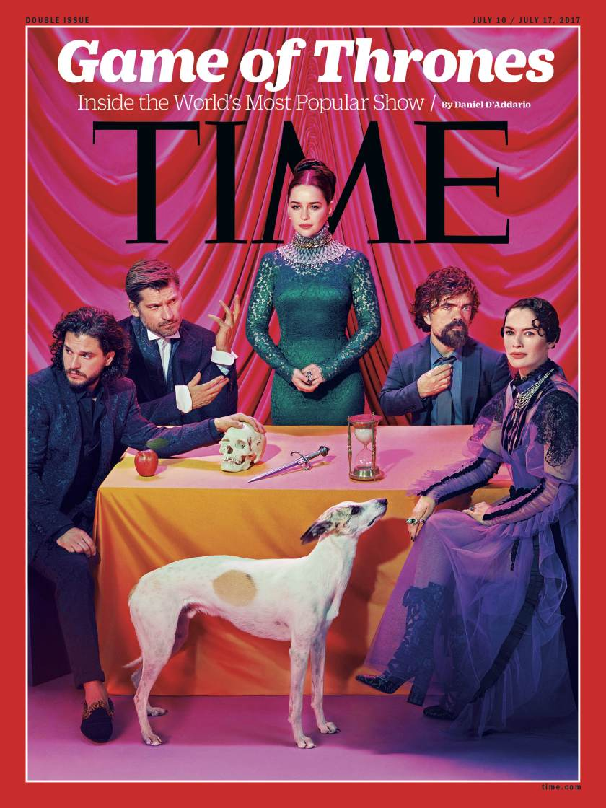
Entertainment too has consequences
Notes:
Entertainment – have consequences?
How relevant is GoT?

Slide 7
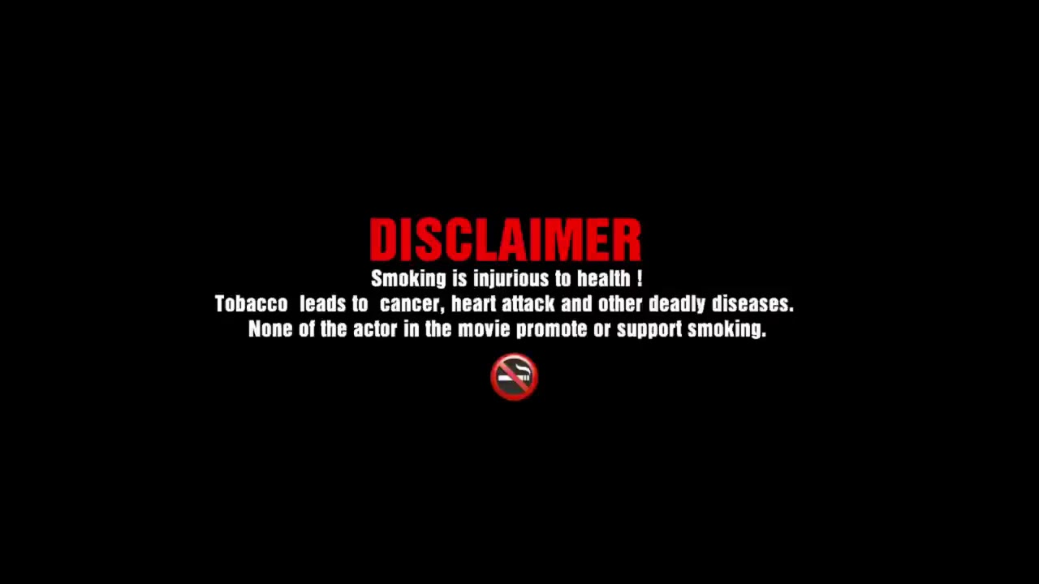
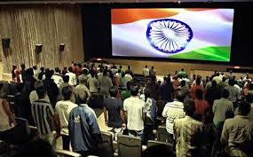

Slide 8
Separating News and entertainment is a false one
Notes:
Separating News and entertainment is a false one
Way in which news is said and portrayed – creates a the picture in you mind…
If you read about road accidents what comes to your mind?
When you read about corruption in the government what do you think and make sense of

Slide 9
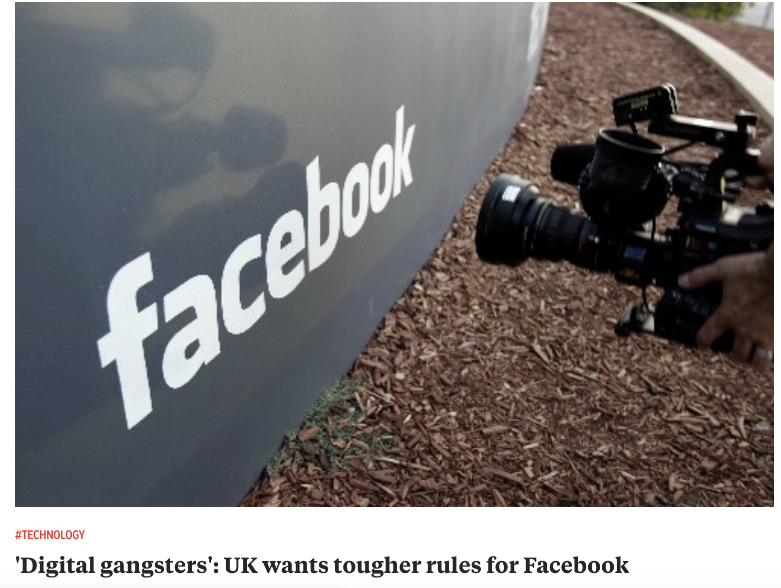

Slide 10
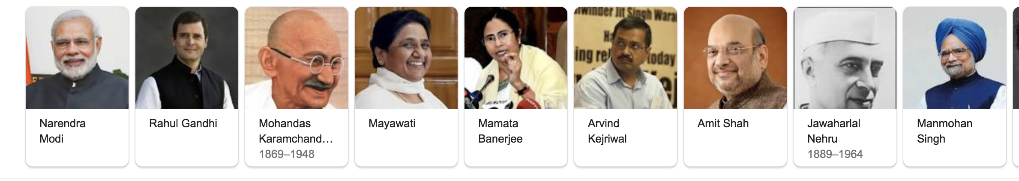
Notes:
The president – in real life and in the movies – how we think about politics is possibly form what we see in the movies
The water gate scandal
Recording every minute of what goes on in the parliament; the white house; the rashtrapati bhavan
Imagine the PM saying WTF which is recorded and goes viral!

Slide 11
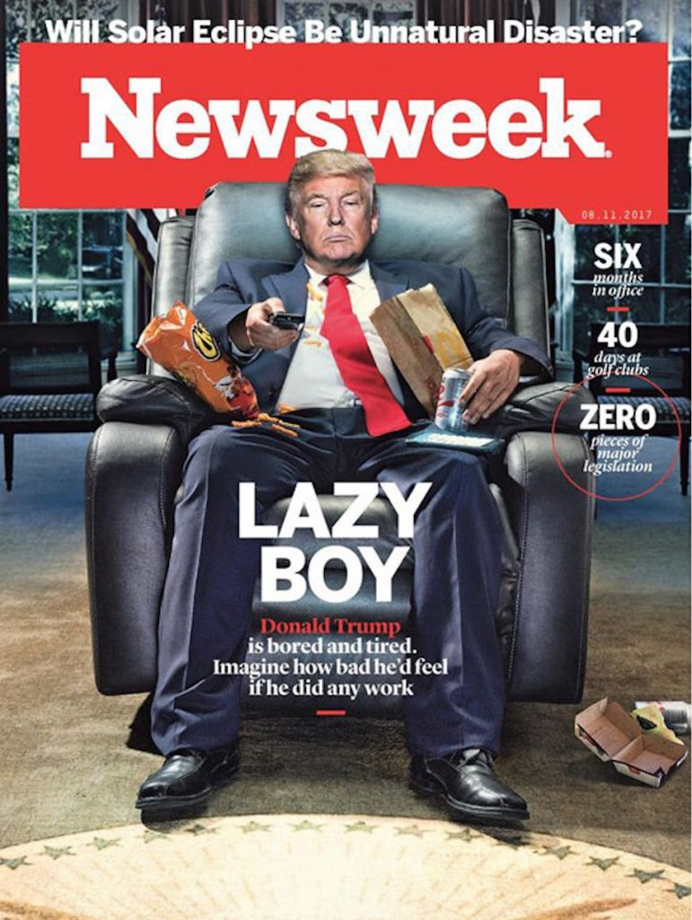
Media disturbs consciousness…
Notes:
Transfusion model - media for disturbing our consciousness
Transfusion- where do these ideas come from? Attribute all the social consequences to media- films and comics a promoting violence
A mystical power to the media
Media and rates of violence
Japan – comic books – low rates of violence and high rates of comic violence overly
does media work through transfusion? What about reader’s choice?

Slide 12
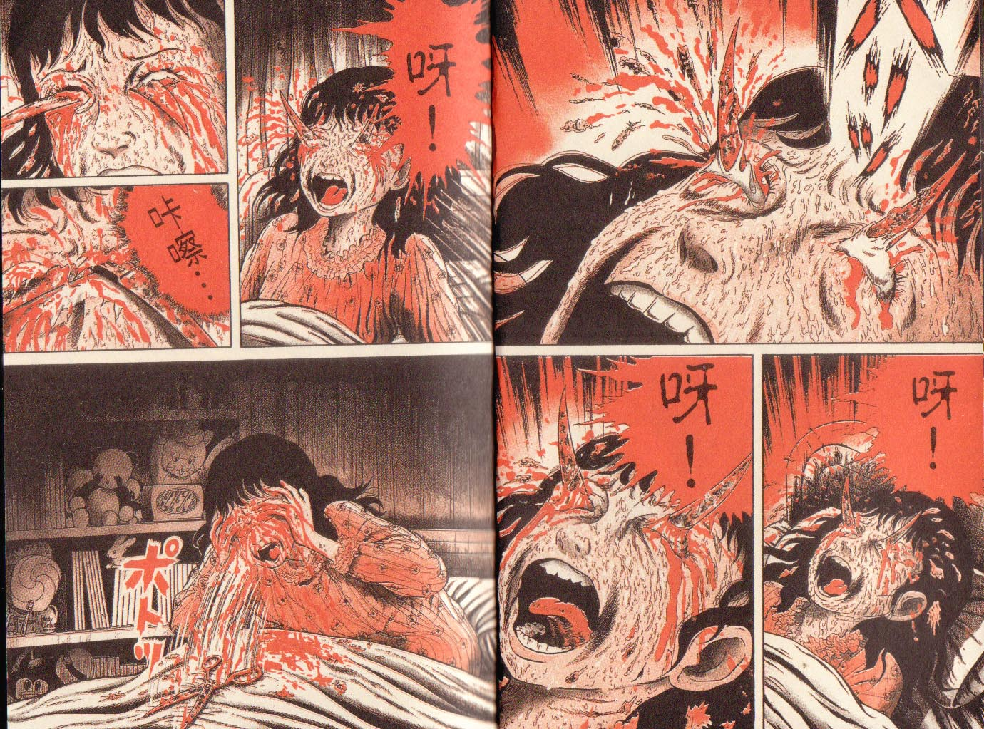

Slide 13
Socialization of media choices
Notes:
What to see, read listen to? Is it Related to your class; caste; leaning; ideology-
selection of media according to what we are socialized to believe in and based on significant others in their life-

Slide 14
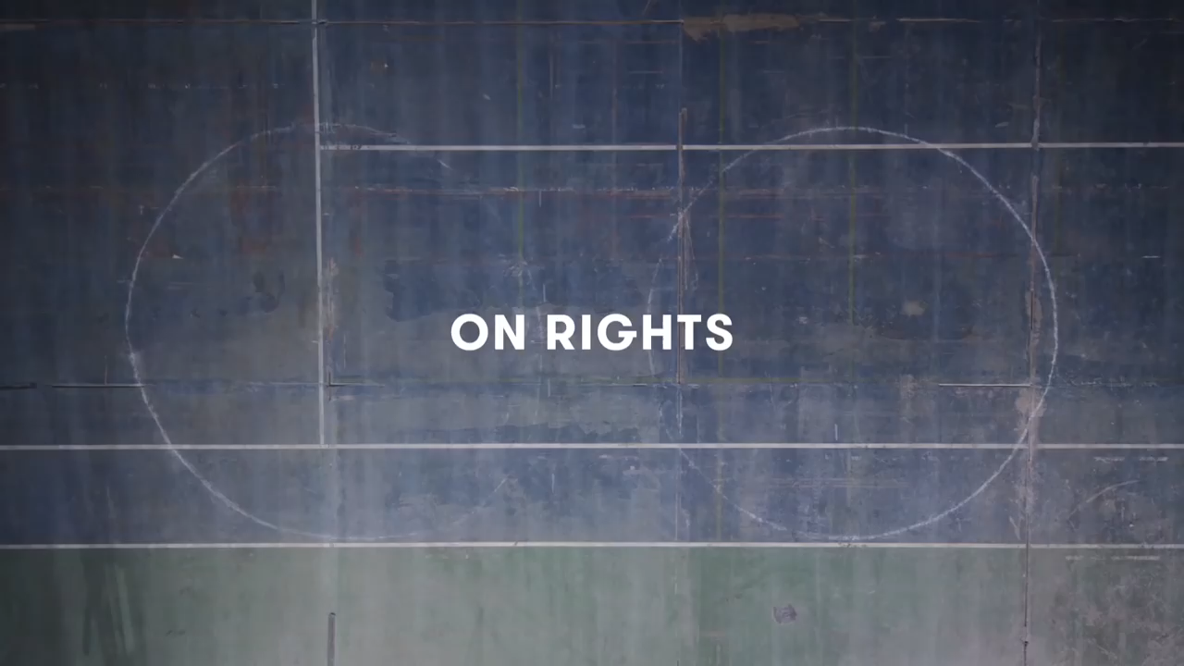

Slide 15
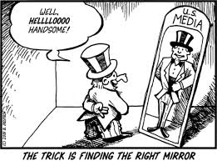
Media as mirror- the reality out there
Notes:
Mirror- the reality out there made available
Knowledge in the head – a product of many –production apparatus – constructing contents carried in the mind- media paly a role here but not a singular one
Media is a part of that not the whole
What is made available by the times of india

Slide 16
So… how is news made…

Slide 17
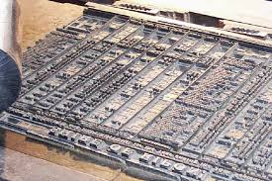
The news hole
Notes:
they have everything that happened yesterday- consequences?
Sunday has the thickest paper – more ads than what happened? Most content?
News Hole – lay out – ad dept. – mark up based on placements of ads – the rest is the news hole
More ads More copy- Cars Tyres- sections that correspond to these business
Commercial role of the newspaper
Latent functions – what is going on? Selling audience/publics to advertisers…. Another aspect- not only a conveyer belt for ads?????
Thursday – selling audience to the food industry – appropriate stories in the news holes on Friday – Latent functions

Slide 18
Newspapers… sell audiences to…
Notes:
they have everything that happened yesterday- consequences?
Sunday has the thickest paper – more ads than what happened? Most content?
News Hole – lay out – ad dept. – mark up based on placements of ads – the rest is the news hole
More ads More copy- Cars Tyres- sections that correspond to these business
Commercial role of the newspaper
Latent functions – what is going on? Selling audience/publics to advertisers…. Another aspect- not only a conveyer belt for ads?????
Thursday – selling audience to the food industry – appropriate stories in the news holes on Friday – Latent functions

Slide 19
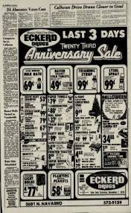
Newspapers… sell audiences to…
Notes:
they have everything that happened yesterday- consequences?
Sunday has the thickest paper – more ads than what happened? Most content?
News Hole – lay out – ad dept. – mark up based on placements of ads – the rest is the news hole
More ads More copy- Cars Tyres- sections that correspond to these business
Commercial role of the newspaper
Latent functions – what is going on? Selling audience/publics to advertisers…. Another aspect- not only a conveyer belt for ads?????
Thursday – selling audience to the food industry – appropriate stories in the news holes on Friday – Latent functions

Slide 20
Who is a news paper person
Notes:
generate a great deal of content under a short time…jobs people are doing
Sociology of occupations- what is it like to be a person in a job – it is to be a newspaper person- what are they thinking? How do they produce fast stories fast – more interesting than most – what kind? Cannot be controversial to the bosses or the advertisers!
Stories from - police; reports are written in a language that is cleaned up – a different texture – this is what the journalists find – written up- writing stories very fast – easy news- in the field- who knows about crimes? Interview criminal- can you write it up as is? Evidence, confirmations etc.…

Slide 21
The media beat
Notes:
Problematize what’s in the media – not just capitalism; transfusions; to think what went on is an astonishing simplification… social context shaping what’s playing with out minds and then visions of the world around you which is used to understand it…
What going on about what’s going on is a complex process- what we make of the world and what it is …. Intimate interaction
Portrayals of reality and what is reality is a false differentiation…
What you might have seen and participated and what you see in the newspapers – socio mission- not just top say it’s a bad record- good reasons for bad records- org forces that give a form to that story…
If it bleeds it leads… dramatic narrative…

Slide 22
Media self as performance if it bleeds it leads
Notes:
Self and society- fused in the social context – sense of self constituted from the performance for each other in the everyday
the object of our own thoughts – implies that selves socially constructed and so is everything else – social walls – walk through walls – humiliated!
Wall like- that are social!
Naïve view- media reflects what? Is there a reality out there and is it captured for consumption…
News from papers; TV; Web – print being the news media????
Reportage where???? Origninary… whats happening on blogs or TV – is it original reporting- who has put that out and who is playing with it?

Slide 23
Media portrayals
Notes:
print/news media count… in the age of web sites/blogs… the original story!
How are they organized – has consequences for the minds that lap up media content – need to bureaucratize the zillion things in media- carving it up- the beat structure and individuals assigned to each office- how is a crime storied from the police- high legitimate authority- just right for the reporters – Mark Fisherman – checks what went on really in the world – crime against the elderly- does not exist in police reporting- a great story – a great hook- press conference – legislature – org for old people- a crescendo for a living- media – police- portrayals – who knows the old crime wave- what’s old, crime, wave? way in which things are organized – intersections [ police govt media etc…] ensemble created the crime wave – tip of the iceberg of these orgs-

Slide 24
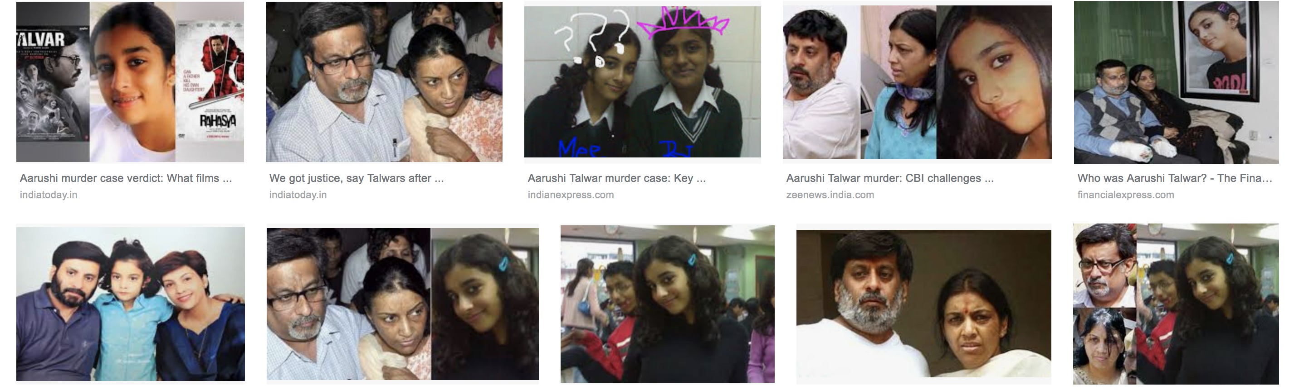
e

Slide 25
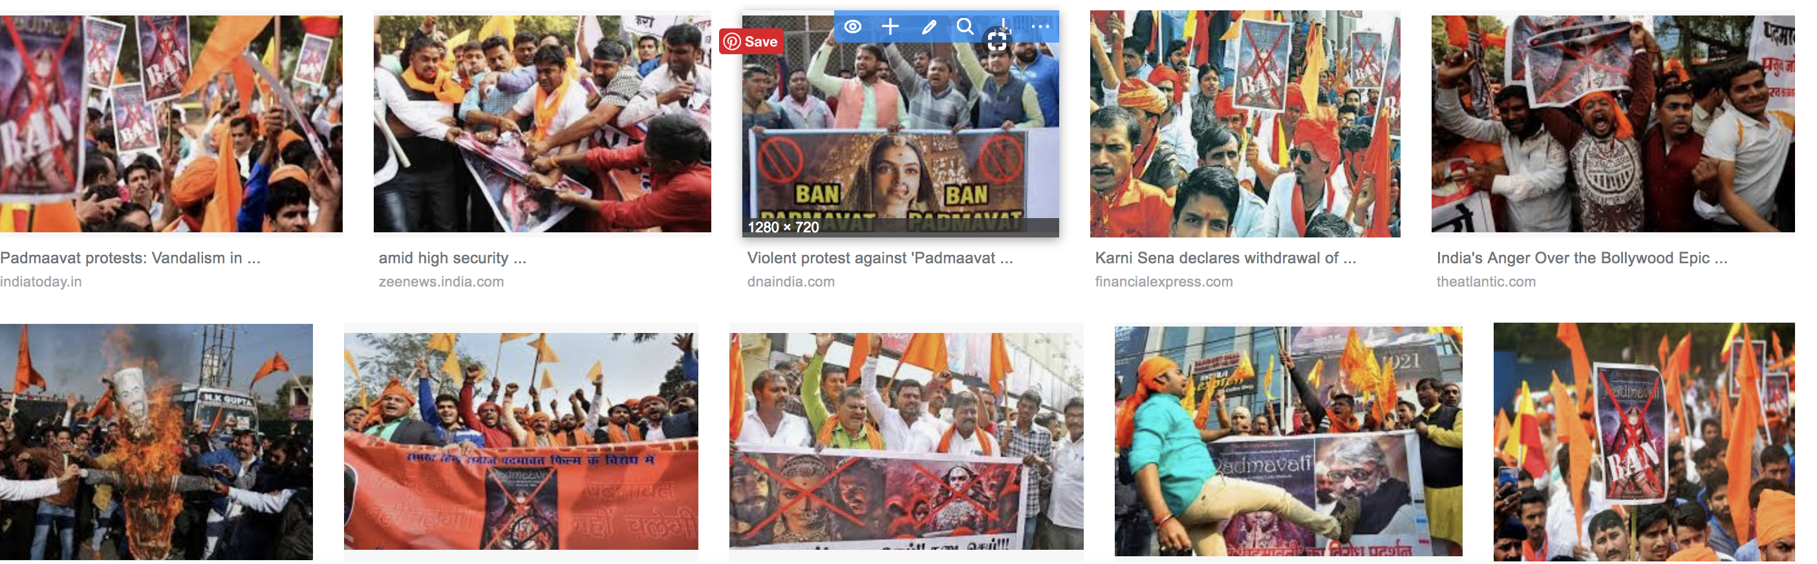

Slide 26
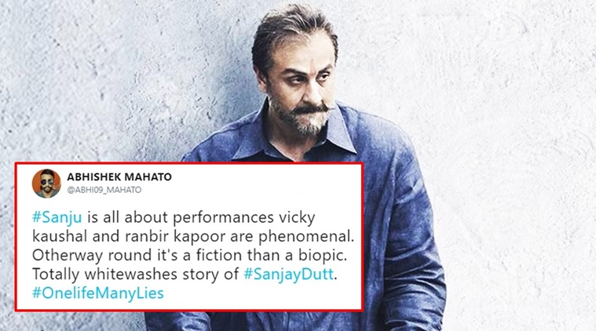

Slide 27
Why a picture isn't a thousand words
Notes:
Alleged reality – images are supposed to be objective – why isn’t the picture a 1000 words?
Can we see the social organizations in these picture and particular ways they are stacked up?
Show news images…
Celebratory Derogatory Demagoguery ; Nationalism is the ideology of the media; objective? When it comes to nation-state not so??

Slide 28
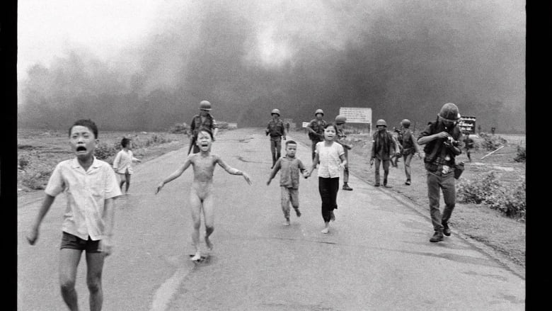
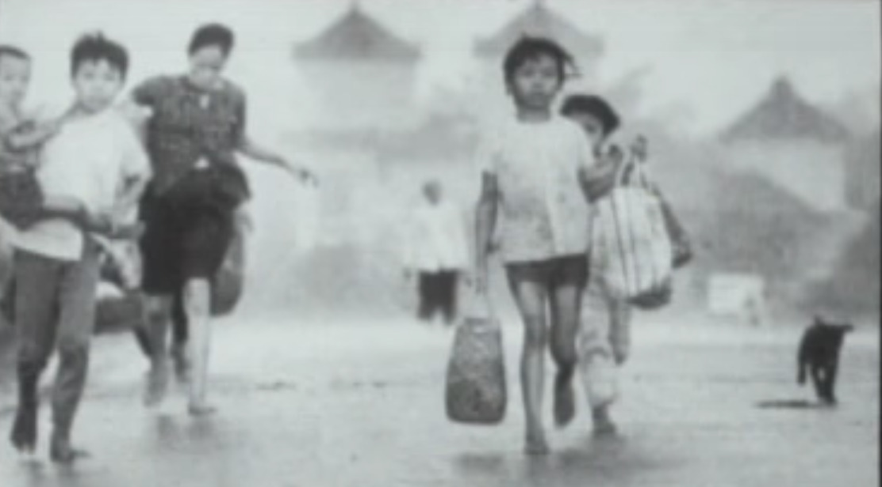
Image - nationalism

Slide 29
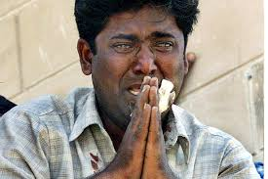
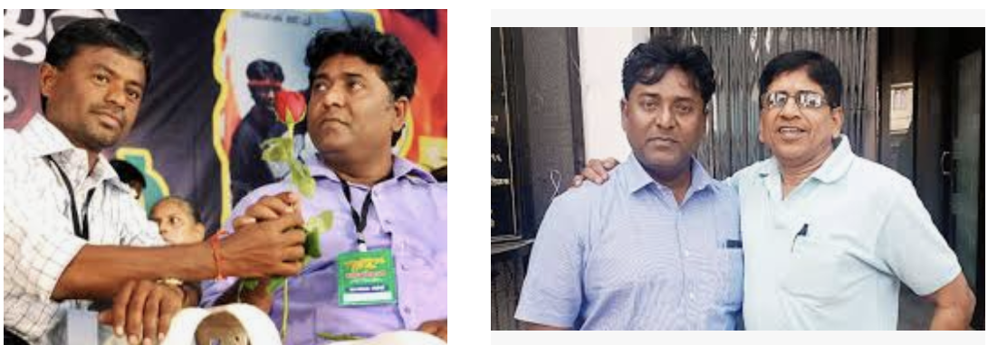

Slide 30
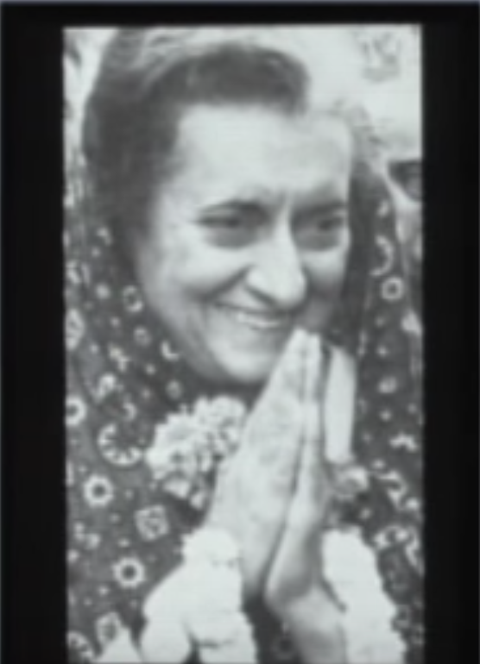
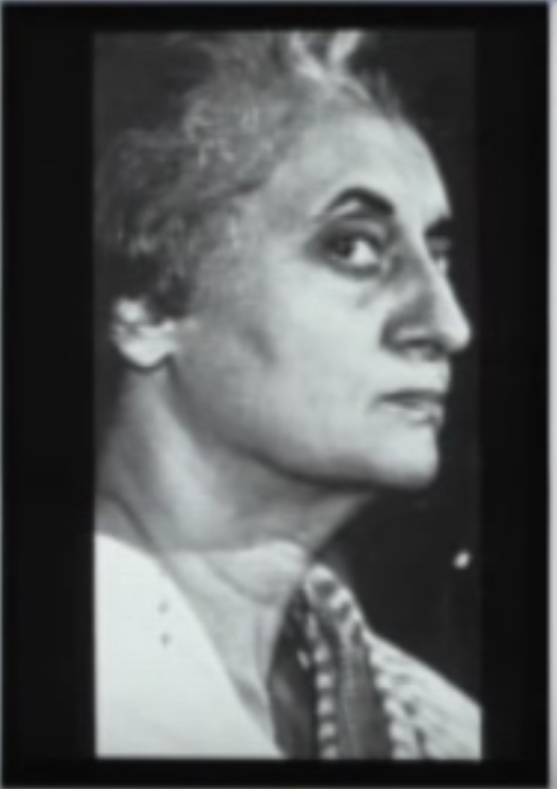
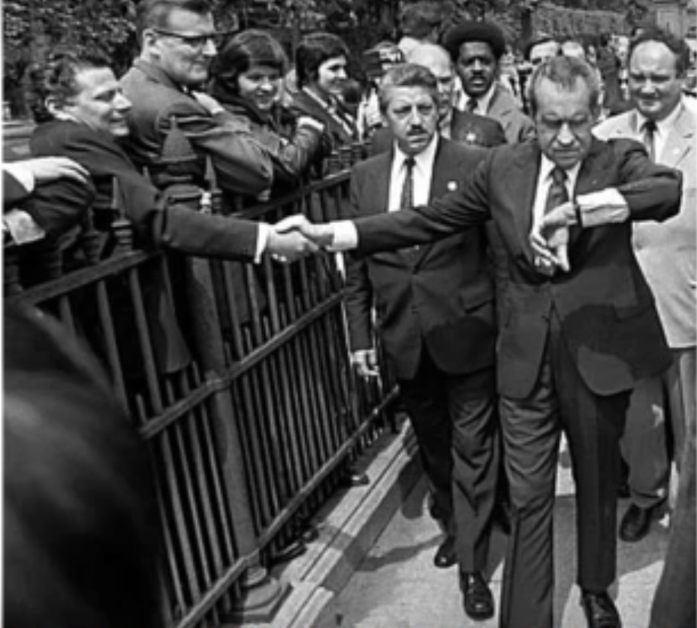
Notes:
Ways of making a face look weak
Stage a photo\ portrait
Ways to organize a photo to elicit emotion – thought gentle thinking leaders
Cropping pictures – ups the narrative saga…
Are these all stunts – theatre- Erving Goffman
Cropping removes information
Different portrayals with different consequences – limited by the sociological imagination
A reservoir of images and thoughts in culture – pulling in these…
Made by context as we are participating in making that context

Slide 31
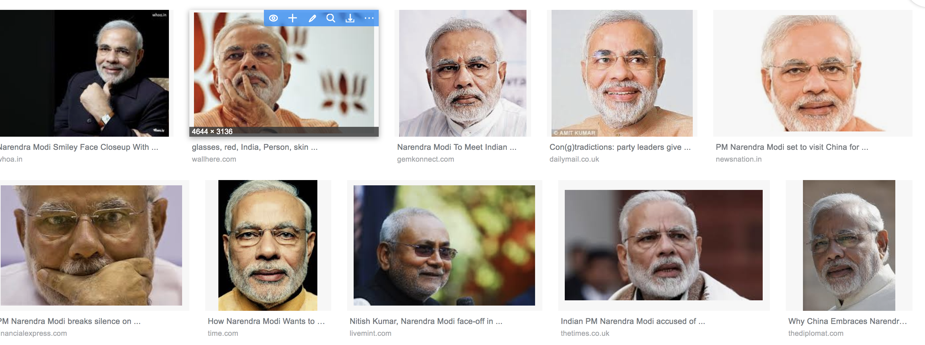
Notes:
Diane Hagerman- news photos captures this and not that- to get across essence of a narrative – coherent- accomplishing the narrative- not just one by many participations – photographer +++
Judging the best picture – looking for a narrative – conventionalized narrative …. How not to be a photojournalist
Fabrication of stock images… the periphery and the center – women bent over the dead body- Madonna and the dead Christ- classic narrative vs the other narrative- simplifies orientation to what's going on and cleaning up the side bits and have the central idea coming through
Operating simple mindedly out of necessity – how much can we take/process/narrate of what's going on….
Seeing the duck and bunny at the same time – cognitively very difficult

Slide 32
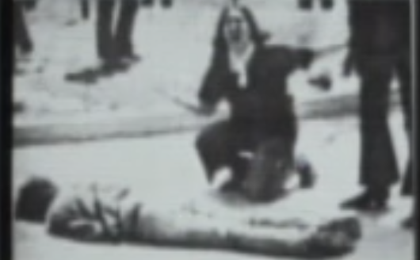
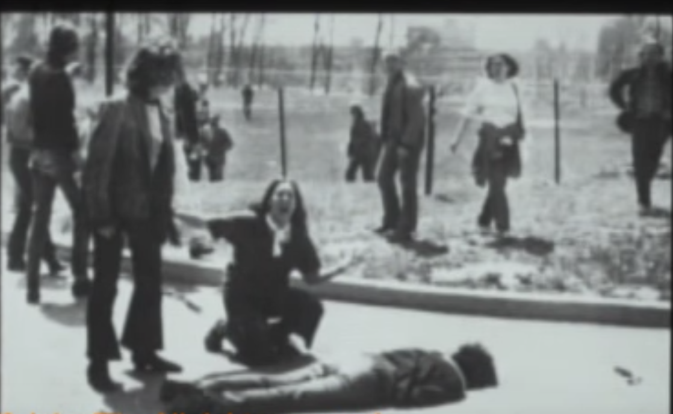

Slide 33
News in the times of Facebook twitter reddit…
Notes:
Source of news is still the same…
TV and the Web feeds off and is dependent on the bureaucracy and beat structure that produces a news report…

Slide 34


